Slide 1


Exploration and Analysis of Gene-Disease Associations
Arun Agarwal, Anna Yannakopoulos, Arjun Krishnan
Notes:
Hi, My name is Arun Agarwal, Junior at Temple University, and I am working alongside biomedical data scientists to analyze correlations between distinct experimental methods for gene-disease relationships.

Slide 2
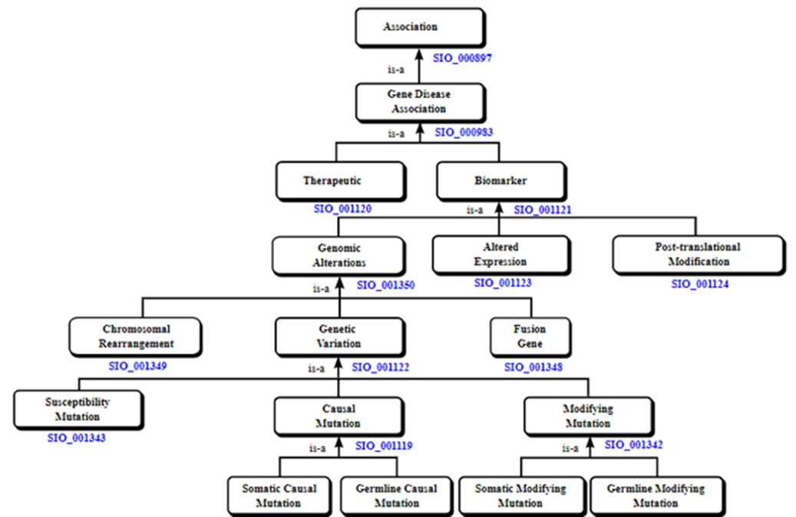
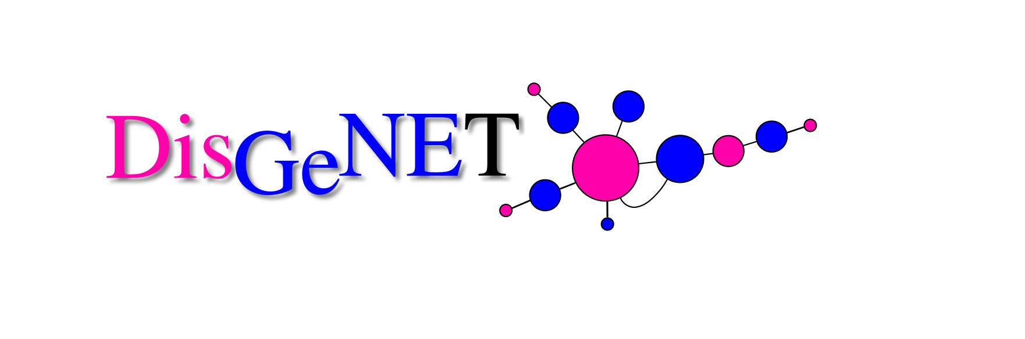
Introduction
Many diseases arise due to disruptions of multiple genes
To work towards cures, the human genome has been studied through various experimental methods that provide different understandings of the disease’s genetic cause
Hypothesis: The genomic basis of complex diseases can be understood on a holistic level through the exploration and combination of genetic data from distinct sources, experimental methods, and association types
DisGeNET: database used with human gene-disease associations
Notes:
There are many diseases that arise due to the contribution of disruptions in multiple genes
To work towards cures for such complex diseases, the human genome has been studied through various experimental methods, each providing a different and sometimes unique understanding of the disease’s underlying genetic cause.
These experimental methods are represented as association types in the hierarchy displayed to the right.
We then hypothesize that:
The genomic basis of complex diseases can be understood on a holistic level through the exploration and combination of genetic data from distinct sources, experimental methods, and association types.
We try to answer:
Do different experimental methods provide the same view of the underlying biology, or do they present different aspects of it?
Can models trained on one experimental method predict the genes associated to another?
We obtained these data from the DisGeNET database, which integrates human gene-disease associations from multiple sources to map over 30,000 human diseases to 20,000+ genes.

Slide 3
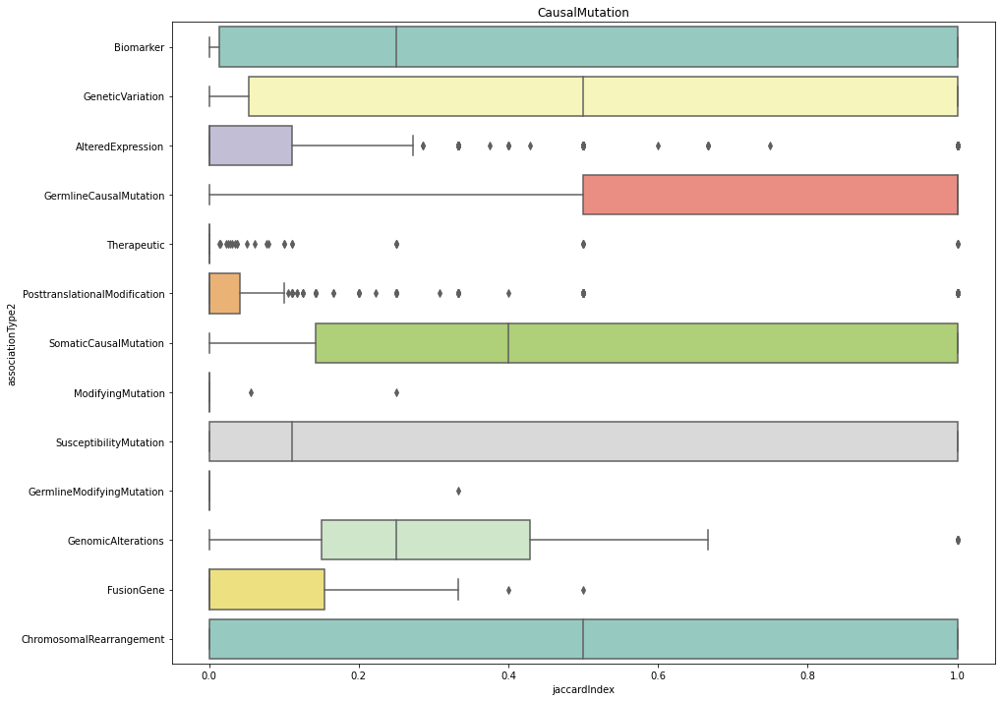
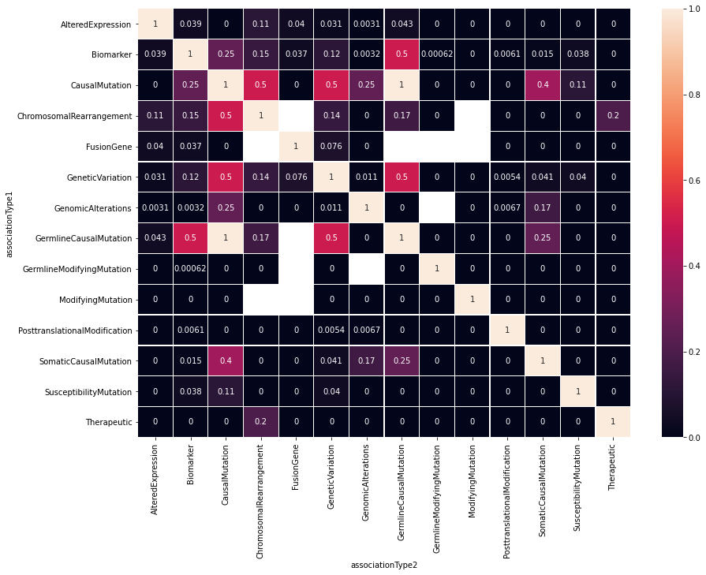
Association Type Exploration
Disease-Gene Attributes File
Gene Sets Dataset
Boxplots and Heatmaps
Notes:
We first performed data exploration of the disease-gene data and the correlated association type hierarchy to understand gene distribution per disease for each source. This led us to the conclusion that it would be better to recategorize the dataset into five association types instead of fifteen to create more succinct plots with equally valuable information.

Slide 4
Association Type Exploration
Disease-Gene Attributes File
Gene Sets Dataset
Boxplots and Heatmaps
Propagated Dataset
Notes:
To sustain the information that would be removed from keeping only a few of the association types, we Propagated the dataset, which means we assigned gene-disease pairs to ancestor association types based on the hierarchy shown earlier.

Slide 5
Association Type Exploration
Disease-Gene Attributes File
Gene Sets Dataset
Boxplots and Heatmaps
Propagated Dataset
Recategorized Dataset (Unique Biomarker)
Recategorized Dataset (All Biomarker)
Notes:
We then Recategorized the dataset into five association types in two different ways, first with only using gene-disease pairs that are unique to biomarker (one of the association types), and then using all biomarker data.

Slide 6
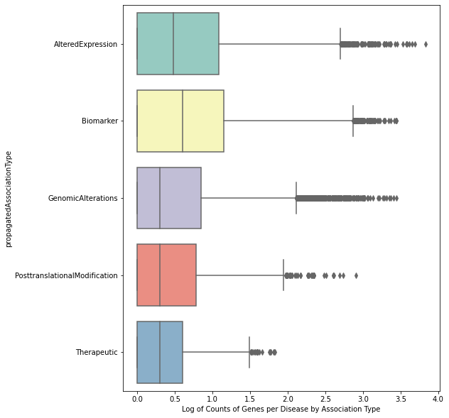
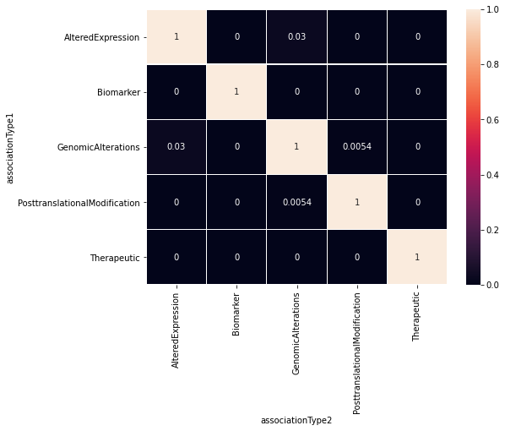
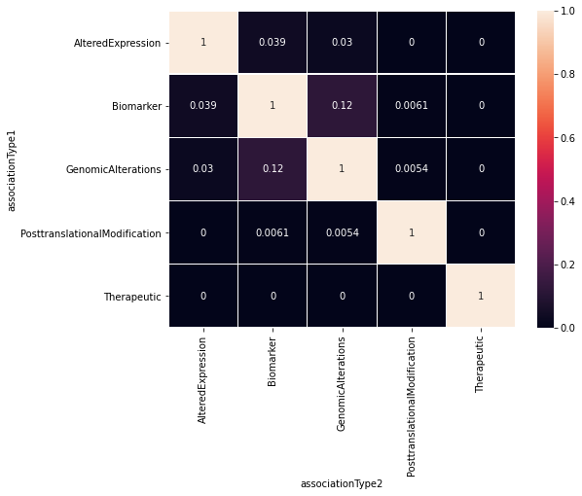
Association Type Exploration
Disease-Gene Attributes File
Gene Sets Dataset
Boxplots and Heatmaps
Propagated Dataset
Recategorized Dataset (Unique Biomarker)
Boxplots and Heatmaps
Recategorized Dataset (All Biomarker)
Boxplots and Heatmaps
Notes:
Compared gene sets from the same disease—yet separate association types—to quantify the overlap between association types using the Jaccard Index, which takes the intersection of the gene sets and divides it by their union.

Slide 7
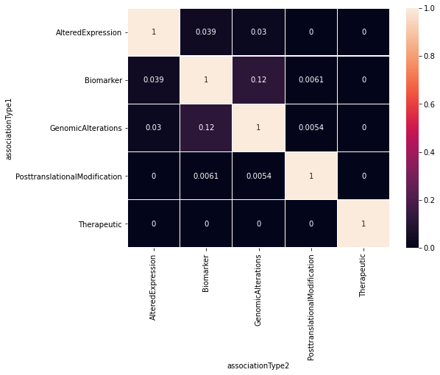
Heatmap of Median Correlation Between Gene Sets for Chosen Association Types
Notes:
This led us to creating the same type of boxplots and heatmaps as before, and the heatmap of the median correlation between gene sets for the five chosen association types is shown here. From this heatmap, we confirmed our prediction that the correlation between association types is very low (based on all the black squares), suggesting different experimental methods do in fact provide almost distinct views of the underlying biology for various gene-disease pairs.

Slide 8
Sources Exploration
Disease-Gene Attributes File
Gene Sets Dataset
Boxplots and Heatmaps
Curated Data File
Disease Mappings File
Boxplots and Heatmaps
Propagated Dataset
Recategorized Dataset (Unique Biomarker)
DOID Curated Dataset
Recategorized Dataset (All Biomarker)
Boxplots and Heatmaps
Notes:
We needed to work with this dataset some more before continuing forward with it in the machine learning process. Since that would take some time, we thought we would set up the rest of the workflow by using a curated dataset, which compares sources instead of association types, to get a different sense of genes for a particular disease.

Slide 9
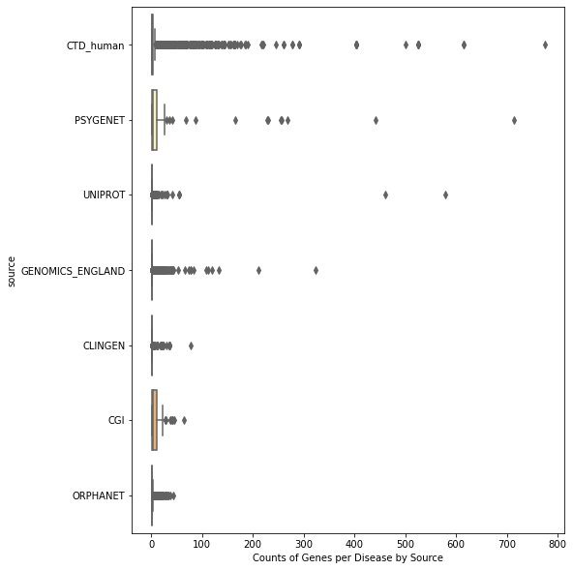
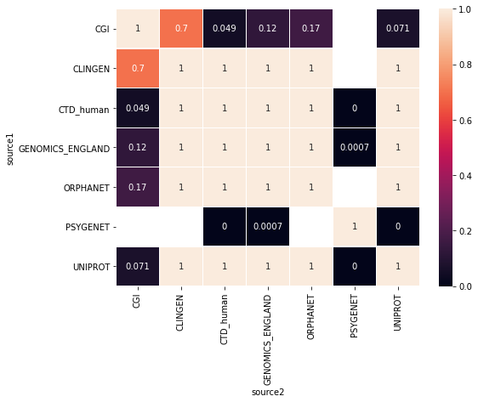
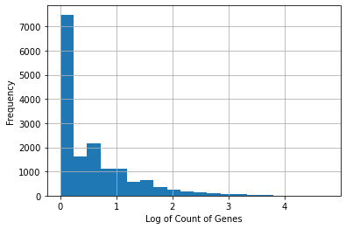
Sources Exploration
Disease-Gene Attributes File
Gene Sets Dataset
Boxplots and Heatmaps
Curated Data File
Disease Mappings File
Boxplots and Heatmaps
Propagated Dataset
Recategorized Dataset (Unique Biomarker)
DOID Curated Dataset
Boxplots. Heatmaps, and Histograms
Recategorized Dataset (All Biomarker)
Boxplots and Heatmaps
Notes:
Like before, we created boxplots and heatmaps to better understand this dataset.

Slide 10
Heatmap of Median Correlation Between Gene Sets for All Sources
Notes:
So, the heatmap would compare the median correlation between gene sets for sources. Based on all the perfect correlations between source pairs (represented by the tan squares with values of 1), we decided we should filter the data to meet conditions like a minimum gene set size

Slide 11
Sources Exploration
Disease-Gene Attributes File
Gene Sets Dataset
Boxplots and Heatmaps
Curated Data File
Disease Mappings File
Boxplots and Heatmaps
Propagated Dataset
Recategorized Dataset (Unique Biomarker)
DOID Curated Dataset
Boxplots. Heatmaps, and Histograms
Recategorized Dataset (All Biomarker)
Boxplots and Heatmaps
Disease Ontology
Filtered and Selected Diseases
Notes:
To obtain this minimum gene set size, we used histograms that visualized the amount of each gene set size. So, The dataset was propagated and filtered using a disease ontology and selected gene boundaries

Slide 12
Sources Exploration
Disease-Gene Attributes File
Gene Sets Dataset
Boxplots and Heatmaps
Curated Data File
Disease Mappings File
Boxplots and Heatmaps
Propagated Dataset
Recategorized Dataset (Unique Biomarker)
DOID Curated Dataset
Boxplots. Heatmaps, and Histograms
Recategorized Dataset (All Biomarker)
Boxplots and Heatmaps
Disease Ontology
Filtered and Selected Diseases
Labels for Machine Learning Model
Cross-Validated Disease-Gene Predictions
Notes:
We could now apply a supervised machine learning approach on the manually chosen diseases from the filtered dataset to determine if, for any given disease, models trained on one source can predict genes associated to another source

Slide 13
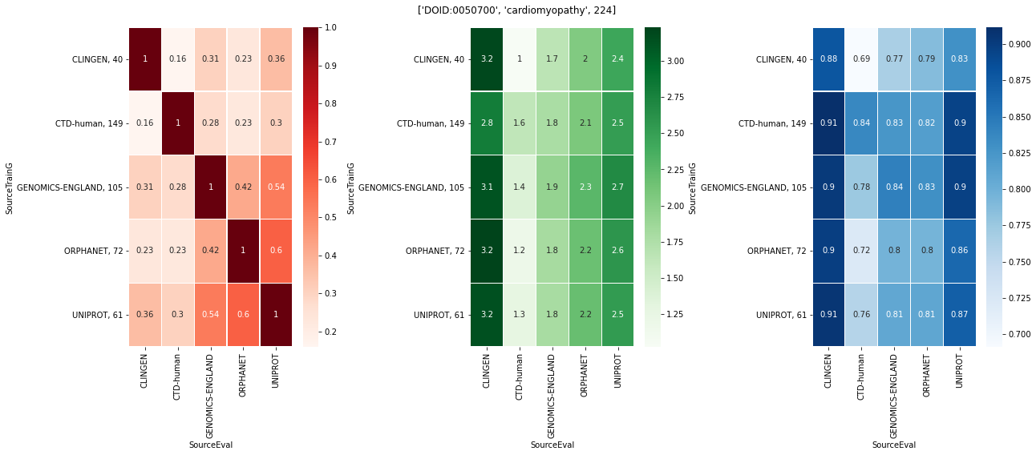
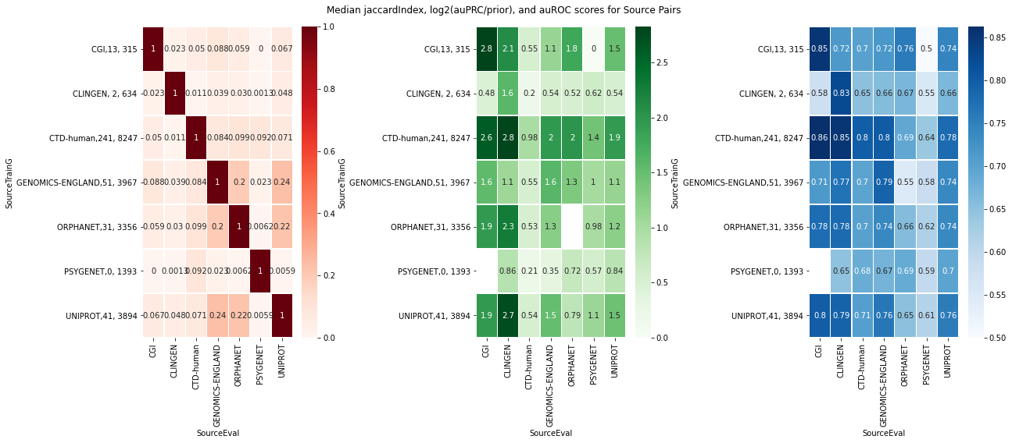
Sources Exploration
Disease-Gene Attributes File
Gene Sets Dataset
Boxplots and Heatmaps
Curated Data File
Disease Mappings File
Boxplots and Heatmaps
Propagated Dataset
Recategorized Dataset (Unique Biomarker)
DOID Curated Dataset
Boxplots. Heatmaps, and Histograms
Recategorized Dataset (All Biomarker)
Boxplots and Heatmaps
Disease Ontology
Performance Metric Heatmaps
Filtered and Selected Diseases
Labels for Machine Learning Model
Cross-Validated Disease-Gene Predictions
Performance Metrics Dataset
Notes:
We visualized various performance metrics from our disease-gene prediction model to highlight improvement of our novel framework over a random baseline

Slide 14
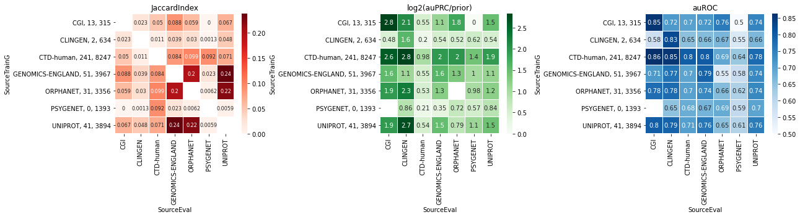
Heatmaps of Median Correlation Score Between Gene Sets, log2(auPRC/prior) Score, and auROC Score for All Sources
Notes:
This visualization came in the form of three heatmaps, the first comparing the median correlation between gene sets as we did prior, the second showing the median log2(auPRC/prior), which tells us how much better our model did than random performance, and a third showing the median auROC, which tells us the probability that, if we select one positive and one negative from our data, our model will rank the positive higher than the negative. These results will need to be examined in detail in the future, but we can see that certain sources or experimental methods do in fact do a better job at predicting genes associated to another source.

Slide 15
Conclusion
We tried to answer:
Do different experimental methods provide the same view of the underlying biology, or do they present different aspects of it?
Can models trained on one experimental method predict the genes associated to another?
Notes:
Overall, we determined some sources and association types demonstrate little correlation to others, represented by their low jaccard index values. However, a few provide similar views of the underlying biology. Furthermore, based on the high performance metrics for certain sources trained or evaluated on, models trained on one experimental method can predict genes associated to another.

Slide 16
Next Steps
Create an ensemble model
Make my work available for further disease study
Notes:
From here, we plan to combine the machine learning models from the distinct sources into an ensemble model that discovers novel genes across the human genome associated with the disease. I will also make my work readily available to members of the Krishnan laboratory to allow the results to be incorporated into further disease study.

